Slide 1
Computer Networks
Spring 2022

Slide 2
Overview
Introduction: course description ( Why to learn? What to learn? How to learn?)
Answers to frequently asked questions

Slide 5

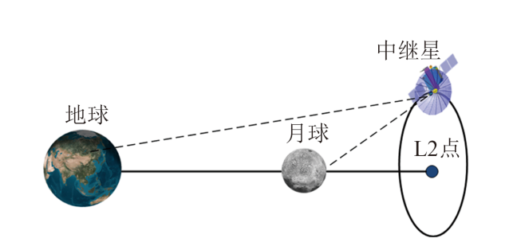
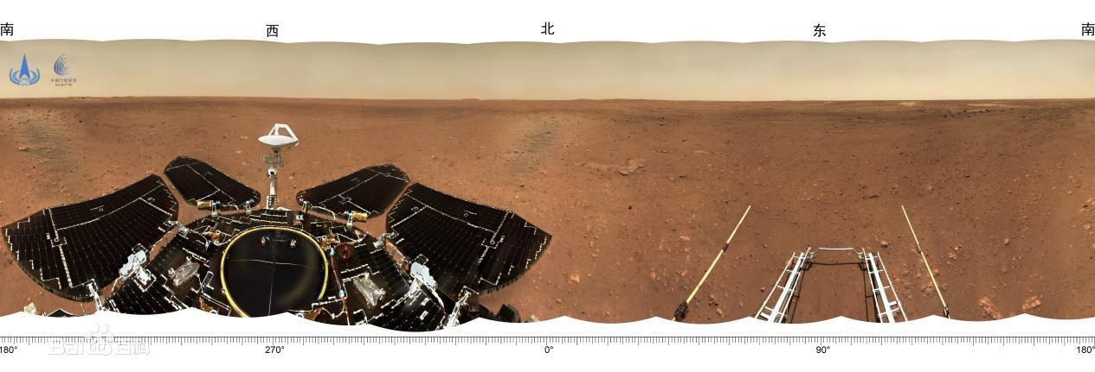
通过鹊桥传回的月球背面图像 鹊桥中继星的作用
祝融号火星车传回的图像

Slide 6

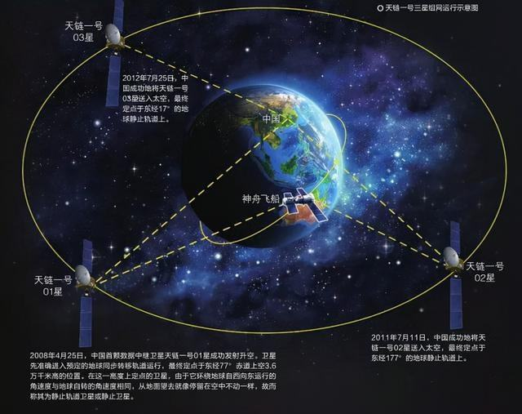
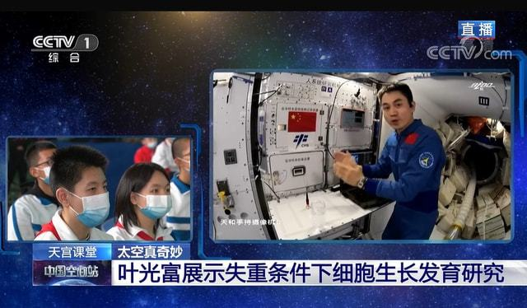
“天宫课堂”第一课开讲
天链一号实现全球无缝链接通信

Slide 7

Metaverse一词在2021年12月，入选《柯林斯词典》2021年度热词；
12月6日，入选“2021年度十大网络用语”；
12月8日，入选《咬文嚼字》“2021年度十大流行语”。

Slide 8
Overview
Introduction: course description ( Why to learn? What to learn? How to learn?)
Answers to frequently asked questions

Slide 9
Course Grading
Textbook
1.Computer Networking: A Top Down Approach, 7th ed., Pearson/Addison Wesley
2.计算机网络:自顶向下方法, 原书第7版, 机械工业出版社
3.何顶新，郑定富，胡晓娅. 计算机网络及应用，北京：化学工业出版社，2011.06
Assignments (experiment + homework ）+ attendance
30%
Final 70%

Slide 10
Chapter 1: introduction
Overview:
Terminology and Concepts related to
“ Computer Network”
  use Internet as example
What’s a protocol?
Protocol layers and their service models
Internet history
Keypoints:
Protocol and three essential factors
Protocol layers and layered architecture
协议层和分层结构
Difficulties:
Connection-oriented and connectionless
Circuit switching and packet switching
电路交换和分组交换
Delay and how to calculate the delay
延迟和如何计算延迟

Slide 11
Chapter 1: roadmap
  1.1 What is the Internet?
  1.2 Network edge
    hosts, access network, physical media
  1.3 Network core
    packet switching, circuit switching, network structure
  1.4 Delay & loss in packet-switched networks
  1.5 Protocol layers, Service models
  1.6* Internet history
Notes:
11

Slide 12
















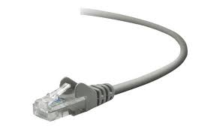
What’s the Internet: “nuts and bolts” view
Billions of connected computing devices:
  hosts = end systems
  running network apps at Internet’s “edge”
mobile network
national or global ISP
Packet switches: forward packets (chunks of data)
  routers, switches
local or regional ISP
Internet
Communication links
  fiber, copper, radio, satellite
  transmission rate: bandwidth
home network
content
provider
network
datacenter
network
Networks
  collection of devices, routers, links: managed by an organization
enterprise
network
Notes:
12
螺母螺栓，具体细节
Packet分组

Slide 13






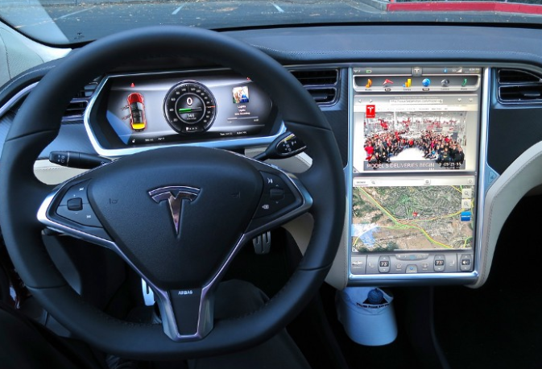




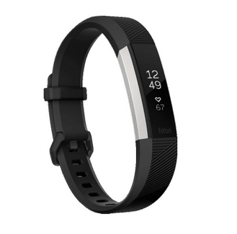
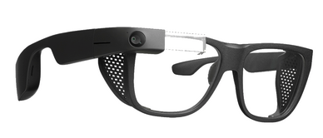
“Fun” Internet-connected devices
Pacemaker & Monitor
scooters
Amazon Echo
IP picture frame
bikes
Internet
refrigerator
Slingbox: remote
control cable TV
cars
Security Camera
Tweet-a-watt:
monitor energy use
AR devices
Internet phones
Fitbit

Slide 14
What’s the Internet: “nuts and bolts” view
Internet: “network of networks”
  Interconnected ISPs
4G
national or global ISP
IP
Streaming
video
protocols are everywhere
  control sending, receiving of messages
  e.g., HTTP (Web), TCP, IP, WiFi,
  streaming video, Skype, 4G, Ethernet
Skype
local or regional ISP
home network
content
provider
network
HTTP
datacenter
network
Internet standards
  RFC: Request for Comments
  IETF: Internet Engineering Task Force
Ethernet
TCP
enterprise
network
WiFi

Slide 15
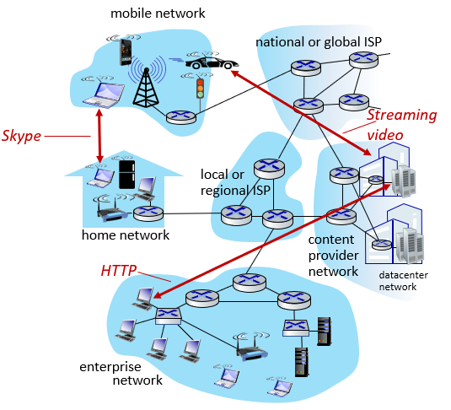
What’s the Internet: a service view
Infrastructure that provides services to applications:
  Web, streaming video, multimedia teleconferencing, email, games,
  e-commerce, social media,
  inter-connected appliances, …
provides programming interface to distributed applications:
  “hooks” allowing sending/receiving apps to “connect” to, use Internet transport service
  provides service options,
  analogous to postal service

Slide 16
Chapter 1: roadmap
  1.1 What is the Internet?
  1.2 Network edge
    hosts, access network, physical media
  1.3 Network core
    packet switching, circuit switching, network structure
  1.4 Delay & loss in packet-switched networks
  1.5 Protocol layers, Service models
  1.6* Internet history
Notes:
16

Slide 17
A closer look at network structure:
mobile network
Network edge:
hosts (End systems):
  Run application programs
  e.g. Web, email
  At “edge of network”
  clients and servers
Client/server model
  Client host requests, receives service from always-on server
  E.g. Web browser/server; email client/server
Peer-to-peer model对等模式
  Minimal (or no) use of dedicated servers
  E.g. Skype, BitTorrent, KaZaA
national or global ISP
local or regional ISP
home network
content
provider
network
datacenter
network
enterprise
network

Slide 18
A closer look at network structure:
Network edge:
hosts: clients and servers
servers often in data centers
Access networks, physical media:
wired, wireless communication links
mobile network
national or global ISP
local or regional ISP
home network
content
provider
network
datacenter
network
enterprise
network

Slide 19
A closer look at network structure:
mobile network
Network edge:
hosts: clients and servers
servers often in data centers
Access networks, physical media:
wired, wireless communication links
Network core:
  interconnected routers
  network of networks
national or global ISP
local or regional ISP
home network
content
provider
network
datacenter
network
enterprise
network

Slide 20
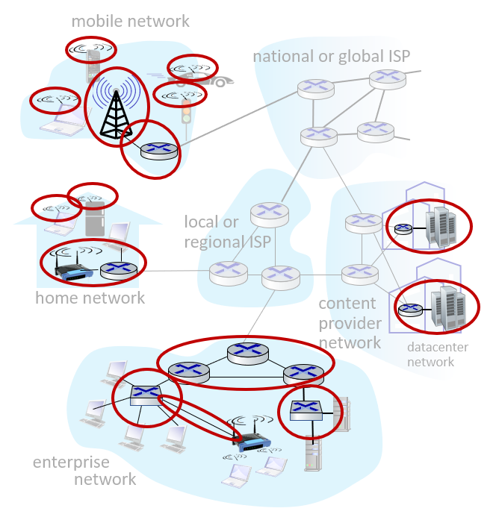
Access networks and physical media
Q: How to connect end systems to edge router?
residential access nets
institutional access networks (school, company)
mobile access networks
(WiFi, 4G/5G)
What to look for:
bandwidth (bits per second) of access network?
shared or dedicated?

Slide 21
Residential Access: Point to Point Access
Dialup via modem
  Up to 56Kbps direct access to router (often less)
  Can’t surf and phone at same time: can’t be “always on”
ADSL: asymmetric digital subscriber line
  Up to 1 Mbps upstream (today typically < 256 kbps)
  Up to 8 Mbps downstream (today typically < 1 Mbps)
HFC: hybrid fiber coax
  Asymmetric: up to 30Mbps downstream, 2 Mbps upstream
  Is shared broadcast medium

Slide 22








Access network: home network
wireless
devices
to/from headend or central office
often combined
in single box
modem
wireless access
point (54 Mbps)
router, firewall, NAT
wired Ethernet (1 Gbps)

Slide 23
Access network: home network

Slide 24









Enterprise access networks (Ethernet)
institutional link to
ISP (Internet)
institutional router
Ethernet
switch
institutional mail,
web servers
typically used in companies, universities, etc.
  10 Mbps, 100Mbps, 1Gbps, 10Gbps transmission rates
  today, end systems typically connect into Ethernet switch

Slide 25








Wireless access networks
shared wireless access network connects end system to router
  via base station aka “access point”
wide-area wireless access
  provided by telco (cellular) operator, 10’s km
  between 1 and 10 Mbps
  3G, 4G: LTE，5G
wireless LANs:
  within building (100 ft.)
  802.11b/g/n/ac/ax (WiFi):
  11, 54, 450 Mbps transmission rate
to Internet
to Internet

Slide 26
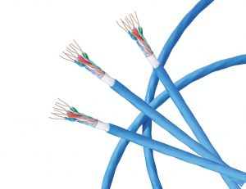
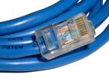
Physical media
bit: propagates between
transmitter/receiver pairs
physical link: what lies between transmitter & receiver
guided media:
  signals propagate in solid media: copper, fiber, coax
unguided media:
  signals propagate freely, e.g., radio
twisted pair (TP)
two insulated copper wires两根绝缘铜线
  Category 5: 100 Mbps, 1 Gbps Ethernet
  Category 6: 10Gbps

Slide 27

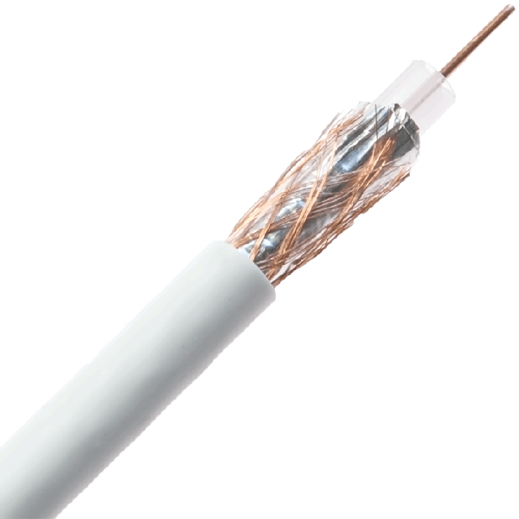
Physical media: coax, fiber
coaxial cable:同轴电缆
two concentric copper conductors
Bidirectional双向的
broadband:
  multiple channels on cable
  HFC
fiber optic cable:光缆
glass fiber carrying light pulses, each pulse a bit光脉冲
high-speed operation:高速运行
  high-speed point-to-point transmission (e.g., 10’s-100’s Gbps transmission rate)
low error rate: 中继器间距大，不受电磁干扰
  repeaters spaced far apart
  immune to electromagnetic noise
中国光谷已成长为中国最大的光纤光缆、光电器件生产基地，最大的光通信技术研发基地。

Slide 28
Physical media: radio
signal carried in electromagnetic spectrum电磁频谱中携带的信号
no physical “wire”
Bidirectional双向
propagation environment effects:传播环境的影响
  reflection
  obstruction by objects物体阻挡
  Interference干涉
radio link types:
terrestrial microwave陆地微波
  e.g. up to 45 Mbps channels
LAN (e.g., WiFi)局域网
  54 Mbps
wide-area (e.g., cellular)
  4G cellular: ~ 10 Mbps
Satellite卫星
  Kbps to 45Mbps channel (or multiple smaller channels)
  270 msec end-end delay
  geosynchronous versus low altitude

Slide 29
Chapter 1: roadmap
  1.1 What is the Internet?
  1.2 Network edge
    hosts, access network, physical media
  1.3 Network core
    packet switching分组交换, circuit switching电路交换, network structure
  1.4 Delay & loss in packet-switched networks
  1.5 Protocol layers, Service models
  1.6* Internet history
Notes:
29

Slide 30
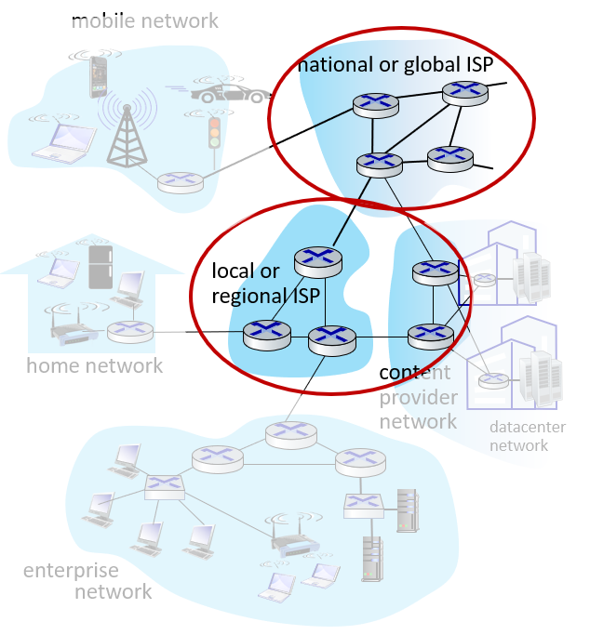
The network core
mesh of interconnected routers互联网路由器
The fundamental根本的 question: how is data transferred through net数据是如何通过网络转送的?
  Circuit-switching: dedicated circuit per call: telephone net
  Packet-switching: data sent through net in discrete “chunks”离散的“块”

Slide 31
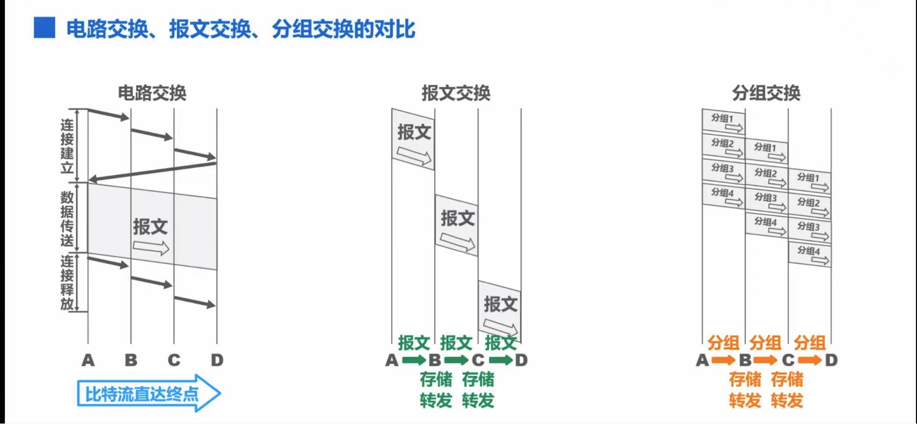
The network core
Message switching and Packet-Switching: Store-and-Forward存储转发

Slide 32
Circuit Switching
End-end resources reserved for “call”预留资源
Link bandwidth链路带宽, switch capacity交换容量
Dedicated resources: no sharing专用资源，不共享
Circuit-like (guaranteed) performance
Call setup required

Slide 33
Circuit Switching
Network resources (e.g., bandwidth) divided into “pieces”资源分块
Pieces allocated to calls分配给通话的pieces
Resource piece idle if not used by owning call (no sharing)
Dividing link bandwidth into “pieces”
  Frequency division频分
  Time division时分

Slide 34
Circuit switching: FDM versus TDM
Example:
FDM
4 users
frequency
time
TDM
frequency
time
Notes:
Two simple multiple access control techniques.
Each mobile’s share of the bandwidth is divided into portions for the uplink and the downlink. Also, possibly, out of band signaling.
As we will see, used in AMPS, GSM, IS-54/136

Slide 35
Numerical Example
How long does it take to send a file of 640,000 bits from host A to host B over a circuit-switched network?
  All links are 1.536 Mbps
  Each link uses TDM with 24 slots
  500 msec to establish end-to-end circuit
  教材P20
Work it out!
Notes:
1536000/24=64000 10s+0.5

Slide 36
Network Core: Packet Switching
Each end-end data stream divided into packets
User A, B packets share network resources
Each packet uses full link bandwidth
Resources used as needed
Resource contention:
Aggregate resource demand can exceed amount available资源需求总量可能超过可用数量
Congestion: packets queue, wait for link use拥塞：数据包排队，等待链接
Store and forward: packets move one hop at a time一跳一次
  Node receives complete packet before forwarding
Bandwidth division into “pieces”
Dedicated allocation
Resource reservation
节点收到完整数据包后再转发

Slide 37
Packet Switching: Statistical Multiplexing
100 Mb/s
Ethernet
A
C
statistical multiplexing
1.5 Mb/s
B
queue of packets
waiting for output
link
D
E
Sequence of A & B packets does not have fixed pattern, shared on demand statistical multiplexing
TDM: each host gets same slot in revolving TDM frame

Slide 38

Host: sends packets of data
host sending function:
takes application message
breaks into smaller chunks, known as packets, of length L bits
transmits packet into access network at transmission rate R
  link transmission rate, aka link capacity, aka link bandwidth
two packets,
L bits each
2
1
R: link transmission rate
host
packet
transmission
delay
time needed to
transmit L-bit
packet into link
L (bits)
R (bits/sec)
=
=

Slide 39



Packet-switching: store-and-forward
L bits
per packet
source
3
2
1
R bps
R bps
destination
Transmission delay: takes L/R seconds to transmit (push out) L-bit packet into link at R bps
store and forward : entire packet must arrive at router before it can be transmitted on next link
one-hop numerical example:
L = 7.5 Mbits
R = 1.5 Mbps
one-hop transmission delay = 5 sec
end-end delay = 2L/R (assuming zero propagation delay)从一个端系统到另一个端系统
more on delay shortly …

Slide 40
Packet switching versus circuit switching
packet switching allows more users to use network!
example:
1 Mb/s link
each user:
  100 kb/s when “active”
  active 10% of time
circuit-switching:
  10 users
packet switching:
  with 35 users, probability > 10 active at same time is less than .0004 *
N
users
…..
1 Mbps link
Q: how did we get value 0.0004?
Q: what happens if > 35 users ?
* Check out the online interactive exercises for more examples: http://gaia.cs.umass.edu/kurose_ross/interactive/

Slide 41
Packet switching versus circuit switching
Probability that a user is active p=0.1
Probability that a user is inactive q=1-p
We want to find N such that concurrent users are more than 10

Slide 42
Packet switching versus circuit switching
is packet switching a “slam dunk winner?”
great for bursty data
  resource sharing
  simpler, no call setup
excessive congestion possible: packet delay and loss
  protocols needed for reliable data transfer, congestion control
Q: How to provide circuit-like behavior?
  bandwidth guarantees needed for audio/video apps
  still an unsolved problem (chapter 7)
Q: human analogies of reserved resources (circuit switching) versus on-demand allocation (packet-switching)?
Notes:
slam dunk 灌篮高手
congestion 拥塞

Slide 43
Internet structure: network of networks
End systems connect to Internet via access ISPs (Internet Service Providers)
  residential, company and university ISPs
Access ISPs in turn must be interconnected.
  so that any two hosts can send packets to each other
Resulting network of networks is very complex
  evolution was driven by economics and national policies
Let’s take a stepwise approach to describe current Internet structure

Slide 44
Internet structure: network of networks
Question: given millions of access ISPs, how to connect them together?
…
…
access
net
access
net
access
net
access
net
access
net
access
net
access
net
…
…
access
net
access
net
access
net
access
net
access
net
access
net
…
access
net
access
net
…
access
net

Slide 45
Internet structure: network of networks
Option: connect each access ISP to every other access ISP?
…
…
access
net
access
net
access
net
access
net
access
net
…
…
access
net
access
net
…
connecting each access ISP to each other directly doesn’t scale: O(N²) connections.
…
…
access
net
access
net
…
access
net
access
net
access
net
…
access
net
…
access
net
access
net
…
access
net

Slide 46
Internet structure: network of networks
Option: connect each access ISP to one global transit ISP?
Customer and provider ISPs have economic agreement.
…
…
access
net
access
net
access
net
access
net
access
net
access
net
access
net
…
…
global
ISP
access
net
access
net
access
net
access
net
access
net
access
net
…
access
net
access
net
…
access
net
Notes:
one global transit ISP 一个全球中转 ISP 一个全球转接服务提供商

Slide 47
Internet structure: network of networks
But if one global ISP is viable business, there will be competitors ….
…
…
access
net
access
net
access
net
access
net
access
net
access
net
ISP A
access
net
…
…
access
net
ISP B
access
net
ISP C
access
net
access
net
access
net
access
net
…
access
net
access
net
…
access
net

Slide 48
Internet structure: network of networks
But if one global ISP is viable business, there will be competitors …. which must be interconnected
Internet exchange point
…
…
access
net
access
net
access
net
access
net
access
net
IXP
access
net
access
net
ISP A
…
…
access
net
IXP
ISP B
access
net
ISP C
access
net
access
net
peering link
access
net
access
net
…
access
net
access
net
…
access
net

Slide 49
Internet structure: network of networks
… and regional networks may arise to connect access nets to ISPs
…
…
access
net
access
net
access
net
access
net
access
net
IXP
access
net
access
net
ISP A
…
…
access
net
IXP
ISP B
access
net
ISP C
access
net
access
net
access
net
regional net
access
net
…
access
net
access
net
…
access
net

Slide 50
Internet structure: network of networks
… and content provider networks (e.g., Google, Microsoft, Akamai) may run their own network, to bring services, content close to end users
…
…
access
net
access
net
access
net
access
net
access
net
IXP
access
net
access
net
ISP A
…
…
Content provider network
access
net
IXP
ISP B
access
net
ISP C
access
net
access
net
access
net
regional net
access
net
…
access
net
access
net
…
access
net

Slide 51
Internet structure: network of networks
Tier 1 ISP
Tier 1 ISP
Google
IXP
IXP
IXP
Regional ISP
Regional ISP
Peer
access
ISP
access
ISP
access
ISP
access
ISP
access
ISP
access
ISP
access
ISP
access
ISP
access ISPs, regional ISPs, tier-1 ISPs,
PoPs, multi-homing, peering, and IXPs
Notes:
Tier 级; 阶; 层; 阶层; 等级;

Slide 52
Internet structure: network of networks

Slide 53
Chapter 1: roadmap
  1.1 What is the Internet?
  1.2 Network edge
    hosts, access network, physical media
  1.3 Network core
    packet switching, circuit switching, network structure
  1.4 Delay & loss in packet-switched networks
  1.5 Protocol layers, Service models
  1.6* Internet history
Notes:
53

Slide 54
How do loss and delay occur?
packets queue in router buffers路由器缓冲区中的数据包队列
packet arrival rate to link (temporarily) exceeds output link capacity
packets queue, wait for turn
packet being transmitted (delay)
A
B
packets queueing (delay)
free (available) buffers: arriving packets
dropped (loss) if no free buffers

Slide 55
Four sources of packet delay
transmission
A
propagation
B
nodal
processing
queueing
d_{nodal} = d_{proc} + d_{queue} + d_{trans} + d_{prop}
d_{proc}: nodal processing 处理时延
check bit errors查错
determine output link
typically < msec
d_{queue}: queueing delay排队时延
time waiting at output link for transmission
depends on congestion level of router路由器的拥塞程度
Notes:
nodal processing 节点处理

Slide 56
Four sources of packet delay
transmission
A
propagation
B
nodal
processing
queueing
d_{nodal} = d_{proc} + d_{queue} + d_{trans} + d_{prop}
d_{trans}: transmission delay传输时延:
L: packet length (bits)
R: link bandwidth (bps)
d_{trans} = L/R
d_{prop}: propagation delay传播时延:
d: length of physical link
s: propagation speed (~2x10⁸ m/sec)
d_{prop} = d/s
d_{trans} and d_{prop}
very different
* Check out the online interactive exercises for more examples: http://gaia.cs.umass.edu/kurose_ross/interactive/
* Check out the Java applet for an interactive animation on trans vs. prop delay
Notes:
56

Slide 57
Excersice-1(nodal delay)
Assuming that the link length d between two hosts is 60m, the link bandwidth R is 10Mbps, and the signal propagation rate s is 2x10⁸ m / s. Now host A sends 1-bit packet to host B.
1) How long does it take for host B to receive this packet? If host A starts transmitting the packet at time t = 0, how far does the front end of the signal of the packet spread at time t = d_{trans}?
2) What if the link length d is 20 meters?
3) If the link length d is 10 meters, what is the specific transmission situation?
4) If host A sends n-bit packet to host B, how long does it take for host B to receive the packet?
A
B

Slide 58
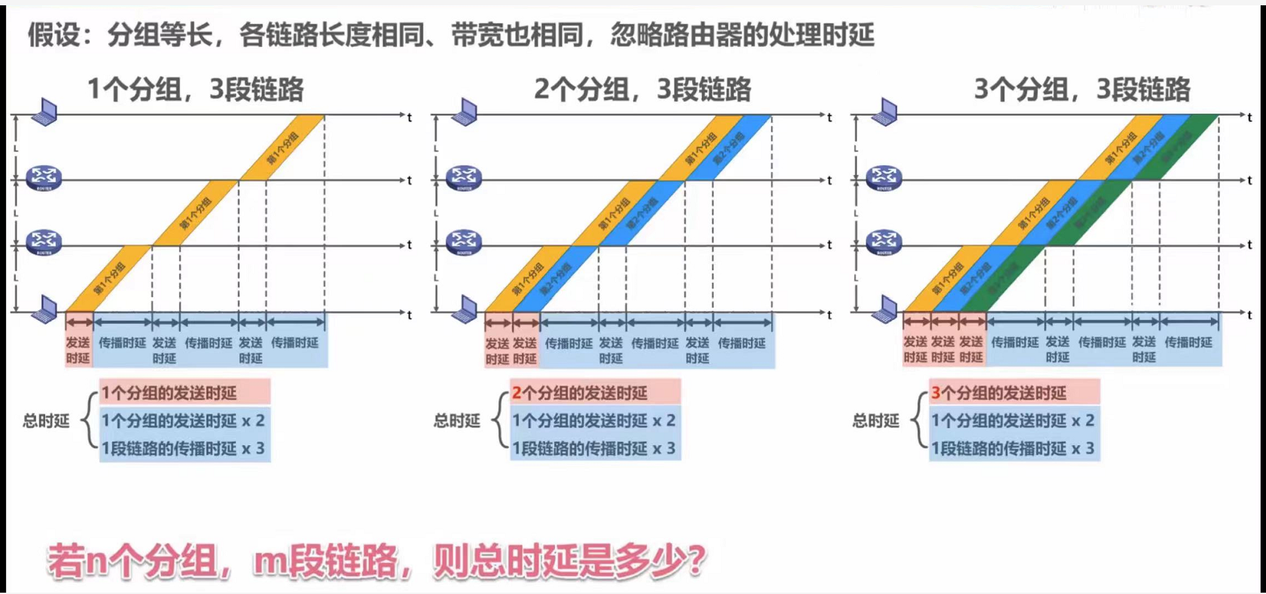
End-to-end delay
A
B

Slide 59
Exercise-2 (end-to-end delay)
L
R
R
R
Message switching and Packet switching: Entire message or packet must arrive at router before it can be transmitted on next link: store and forward
Calculate the end-to-end delay of message switching and packet switching
Example:
L = 7.5 Mbits
R = 1.5 Mbps
t_{prop} : propagation delay of each link
Divide the message into 5000 small packets: l=1.5 kbits

Slide 60
Exercise-3 (end-to-end delay)
The message to be sent is x (bits) in total. There are k links from the source to the destination. The propagation delay of each link is d(s) and the bandwidth is R(bps). In circuit switching, the circuit establishment time is s(s). In packet switching, the message can be divided into several packets with p(bits) length. It is assumed that the processing time and queuing time of the message/packets at each node are ignored.
Q: under what conditions is the end-to-end delay of circuit switching greater than that of packet switching?

Slide 61
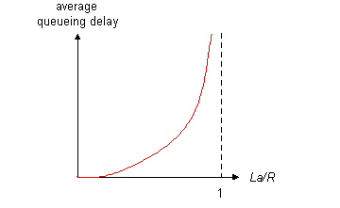

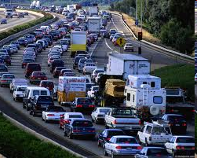
Queueing delay (revisited)
R: link bandwidth (bps)
L: packet length (bits)
a: average packet arrival rate
average queueing delay
traffic intensity
= La/R
La/R ~ 0: avg. queueing delay small
La/R -> 1: avg. queueing delay large
La/R > 1: more “work” arriving
than can be serviced, average delay infinite!
La/R ~ 0
La/R -> 1
* Check online interactive animation on queuing and loss

Slide 62
Packet loss
queue (aka buffer) preceding link in buffer has finite capacity缓冲区容量有限
when packet arrives to full queue, packet is dropped (aka lost)队列已满，丢弃分组
lost packet may be retransmitted by previous node, by source end system, or not at all可能重传
buffer
(waiting area)
A
packet being transmitted
B
packet arriving to
full buffer is lost
* Check out the Java applet for an interactive animation on queuing and loss

Slide 63
Chapter 1: roadmap
  1.1 What is the Internet?
  1.2 Network edge
    hosts, access network, physical media
  1.3 Network core
    packet switching, circuit switching, network structure
  1.4 Delay & loss in packet-switched networks
  1.5 Protocol layers, Service models
  1.6* Internet history
Notes:
63

Slide 64


What’s a protocol?
A human protocol and a computer network protocol:
Hi
TCP connection
request
Hi
TCP connection
response
Got the
time?
GET http://gaia.cs.umass.edu/kurose_ross
2:00
<file>
time
Q: other human protocols?

Slide 65
What’s a protocol?
Human protocols:
“what’s the time?”
“I have a question”
introductions
Network protocols:
computers (devices) rather than humans
all communication activity in Internet governed by protocols互联网上所有通信活动受协议约束
Rules for:一些规则举例
… specific messages sent
… specific actions taken when message received, or other events
Protocols define the format, order of messages sent and received among network entities, and actions taken on message transmission, receipt 协议定义了格式。信息发送接受顺序，在传输信息时执行的操作

Slide 66
3 elements of a protocol
Syntax: Defines how to do it定义操作方法
Semantics: Defines what it is语义:定义是什么
Timing: Defines the order and speed定义时序和速度
Example:
1010110110111011010011001110…
Source Address源地址
Destination Address目的地址
Data传输的数据

Slide 67
Protocol “layers”
Networks are complex,
with many “pieces”:
  Hosts主机
  Routers路由器
  links of various media不同媒介的链路
  Applications应用
  Protocols协议
  hardware, software硬件软件
Question:
is there any hope of organizing structure of network?
是否有希望描绘/讨论网络的结构层次
…. or at least our discussion of networks?

Slide 68
Organization of air travel
ticket (purchase)
baggage (check)
gates (load)
runway takeoff
airplane routing
ticket (complain)
baggage (claim)
gates (unload)
runway landing
airplane routing
airplane routing
a series of steps教材上乘机的例子

Slide 69
Layering of airline functionality
ticket (purchase)
baggage (check)
gates (load)
runway (takeoff)
airplane routing
ticket (complain)
baggage (claim
gates (unload)
runway (land)
airplane routing
ticket
baggage
gate
takeoff/landing
airplane routing
airplane routing
airplane routing
departure
airport
intermediate air-traffic
control centers
arrival
airport
layers: each layer implements a service每一层都实现一项服务
  via its own internal-layer actions自己层的操作
  relying on services provided by layer below下面的层提供的服务

Slide 70
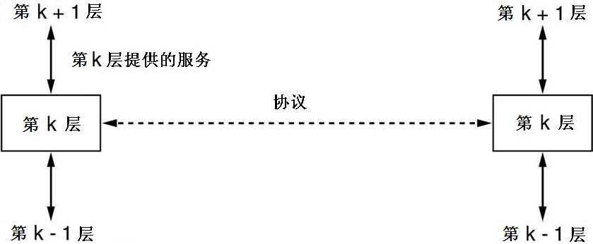
Layering of airline functionality
layers: each layer implements a service
  via its own internal-layer actions
  relying on services provided by layer below

Slide 71
Why layering?
dealing with complex systems:
explicit structure allows identification, relationship of complex system’s pieces通过明确的结构可以识别复杂系统的各个部分，并确定它们之间的关系
  layered reference model for discussion供讨论的分层参考模型
modularization eases maintenance, updating of system模块化便于维护更新系统
  change of implementation of layer’s service transparent to rest of system某层的服务执行改变不影响系统的其他部分
  e.g., change in gate procedure doesn’t affect rest of system
layering considered harmful?
Notes:
显式结构允许识别复杂系统各部分的关系
模块化简化了系统的维护和更新
对系统其余部分透明的层服务的实现更改
例如，门程序的更改不会影响系统的其余部分
分层被认为有害吗？

Slide 72
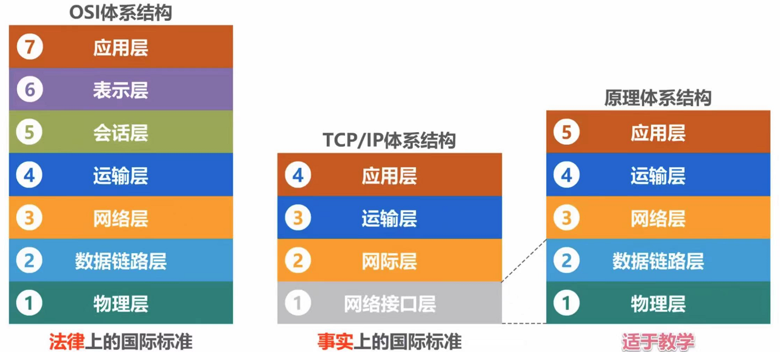
Network architecture
OSI/RM
Internet RM

Slide 73
Internet protocol stack
application: supporting network applications
  FTP, SMTP, HTTP
transport: process-process data transfer
  TCP, UDP
network: routing of datagrams from source to destination将数据报从源站路由到目的地
  IP, routing protocols
link: data transfer between neighboring network elements
  Ethernet, 802.111 (WiFi), PPP
physical: bits “on the wire”
application
transport
network
link
physical

Slide 74
Encapsulation
source
message
M
application
transport
network
link
physical
segment
H_{t}
M
H_{t}
datagram
H_{n}
H_{n}
H_{t}
M
frame
H_{l}
H_{n}
H_{t}
M
link
physical
switch
destination
H_{n}
H_{t}
M
network
link
physical
M
application
transport
network
link
physical
H_{l}
H_{n}
H_{t}
M
H_{n}
H_{t}
M
H_{t}
M
H_{n}
H_{t}
M
H_{l}
H_{n}
H_{t}
M
router

Slide 75
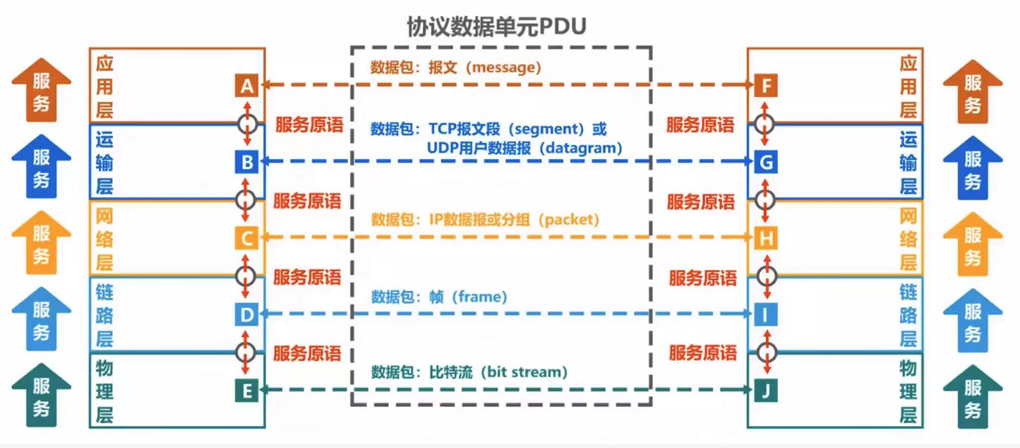
Terminology of network architecture
Entity: hardware and software process that can send and receive information. 实体：可发送和接收信息的硬件和软件过程。
Service: the function provided by the lower layer to the upper layer低层提供给高层的功能
Service access point (SAP): places where entities of two adjacent layers interact服务接入点 (SAP)：两个相邻层的实体进行交互的地方
Service primitives: commands to be exchanged during the interaction between adjacent layers服务基元：相邻层之间交互时要交换的命令

Slide 76
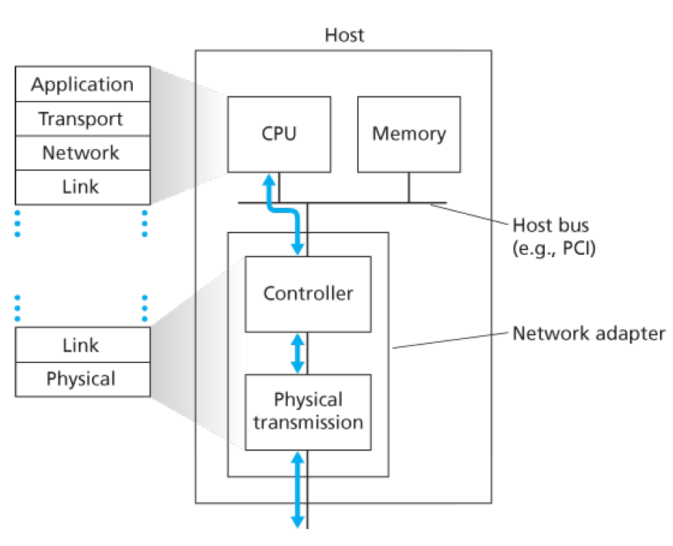
Internet protocol stack
application
transport
network
link
physical

Slide 77
Exercise-4
In the OSI model, the first bottom-up level to provide end-to-end services is ( B )
data link layer B. transport layer C. session layer D. application layer
2. Among the following options, which is not described in the network architecture is ( C )
A. layers in the network B. protocols used by each layer
C. internal implementation details of the protocols
D. functions that must be completed by each layer
3. In the TCP / IP reference model, what directly provides services for the application layer is ( D )
在TCP/IP参考模型中，直接为应用层提供服务的是：
A. presentation layer B. transmission layer C. network layer D. network interface layer网络接口层

Slide 78
Exercise-4
4. Assuming that the application layer in the ISO/OSI reference model wants to send 400B data (without splitting), except the physical layer and application layer, all other layers introduce 20B additional overhead when packaging PDU, the transmission efficiency of the application layer is about ( )
A.80% B.83% C.87% D.91%

Slide 79
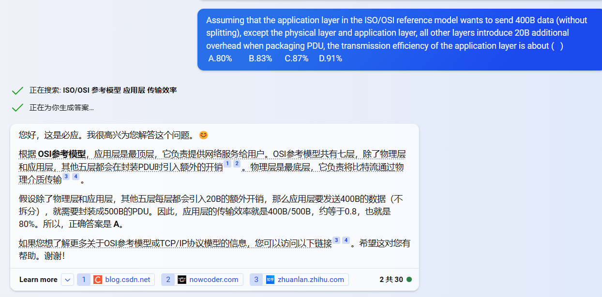

Slide 80
Chapter 1: roadmap
  1.1 What is the Internet?
  1.2 Network edge
    hosts, access network, physical media
  1.3 Network core
    packet switching, circuit switching, network structure
  1.4 Delay & loss in packet-switched networks
  1.5 Protocol layers, Service models
  1.6* Internet history
Notes:
80

Slide 81
Internet History
1961-1972: Early packet-switching principles
1961: Kleinrock - queueing theory shows effectiveness of packet-switching
1964: Baran - packet-switching in military nets
1967: ARPAnet conceived by Advanced Research Projects Agency
1969: first ARPAnet node operational
The first link in the
Internet backbone
SRI
crash
UCLA
The first message: LO!
What was the first message ever sent on the Internet? (LOGIN)
We sent an “L” - did you get the “L”? YEP!
We sent an “O” - did you get the “O”? YEP!
We sent a “G” - did you get the “G”?

Slide 82
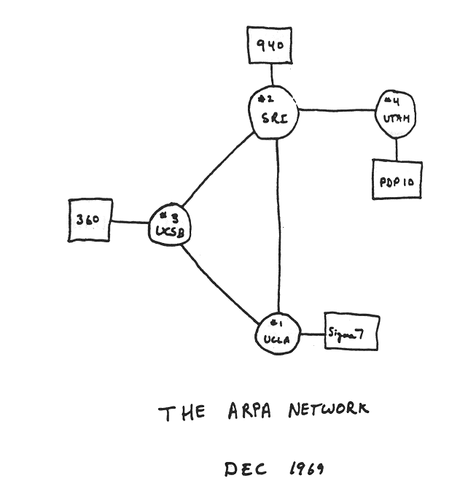
Internet History
1961-1972: Early packet-switching principles
The Internet is Born! at UCLA on October 29, 1969
What it looked like at the end of 1969
1972:
  ARPAnet public demonstration
  NCP (Network Control Protocol) first host-host protocol
  First e-mail program
  ARPAnet has 15 nodes

Slide 83
Internet History
1972-1980: Internetworking, new and proprietary nets
1970: ALOHAnet satellite network in Hawaii
1974: Cerf and Kahn - architecture for interconnecting networks
1976: Ethernet at Xerox PARC
ate70’s: proprietary architectures: DECnet, SNA, XNA
late 70’s: switching fixed length packets (ATM precursor)
1979: ARPAnet has 200 nodes
Cerf and Kahn’s internetworking principles:
  minimalism, autonomy - no internal changes required to interconnect networks
  best effort service model
  stateless routers
  decentralized control
define today’s Internet architecture

Slide 84
Internet History
1980-1990: new protocols, a proliferation of networks
1983: deployment of TCP/IP
1982: SMTP e-mail protocol defined
1983: DNS defined for name-to-IP-address translation
1985: FTP protocol defined
1988: TCP congestion control
New national networks: Csnet, BITnet, NSFnet, Minitel
100,000 hosts connected to confederation of networks

Slide 85
Internet History
1990, 2000’s: commercialization, the Web, new apps
Early 1990’s: ARPAnet decommissioned
1991: NSF lifts restrictions on commercial use of NSFnet (decommissioned, 1995)
Early 1990s: Web
  Hypertext [Bush 1945, Nelson 1960’s]
  HTML, HTTP: Berners-Lee
  1994: Mosaic, later Netscape
  Late 1990’s: commercialization of the Web
Late 1990’s – 2000’s:
More killer apps: instant messaging, P2P file sharing
Network security to forefront
Est. 50 million host, 100 million+ users
Backbone links running at Gbps

Slide 86

Internet History
Recent Developments
High-speed access networking
  10Gbits Ethernet
  Wireless access (UWB, WiMAX, 4G, etc.)
Security
  Internet
  Wireless(5G)
Other networking
  Industrial internet
  Internet of things
  ……

Slide 87
Introduction: Summary
Covered a “ton” of material!
Internet overview
What’s a protocol?
Network edge, core, access network
  Packet-switching versus circuit-switching
Performance: loss, delay
Layering and service models
History
You now have:
Context, overview, “feel” of networking
More depth, detail to follow!

Slide 88
Homework
P95~97
R4,R13,R18
R23,R25
P99~101
P6,P8,P10,P14

